Slide 1

Making Tidy Data
Elizabeth Wickes, @elliewix
Data Curation Specialist
Research Data Service, University of Illinois
Notes:
10.5281/zenodo.161365

Slide 2
Spreadsheet activity
Partner up in some pair or trio configuration
One of you should download the survey_data_spreadsheet_messy.xls file or open it from the files you’ve downloaded
Open it up and, as a group, review the content.
Take 7-10 minutes:
Determine a single set of headers for all the data you see
Make a new sheet in the file and start moving the data over
Then we’ll discuss!

Slide 3
Discussion
What did you discover about the spreadsheet?

Slide 4
Discussion
What was your strategy for reorganization?
What were the column headers that you selected?

Slide 5
Discussion
How would adding the 2014 data impact your design choices?

Slide 6
Humans versus Computers
What you want to type
What your analysis software wants

Slide 7
Humans versus Computers
What will get your analysis done
What you want to type
What your analysis software wants

Slide 8
What is tidy data?
Wickham, Hadley. (August, 2014). “Tidy Data.” Journal of Statistical Software, 10(59).
Don’t describe data in terms of rows and columns.
Data consists of:
Variables
Observations
Values (at the intersection of variables and observations)

Slide 9
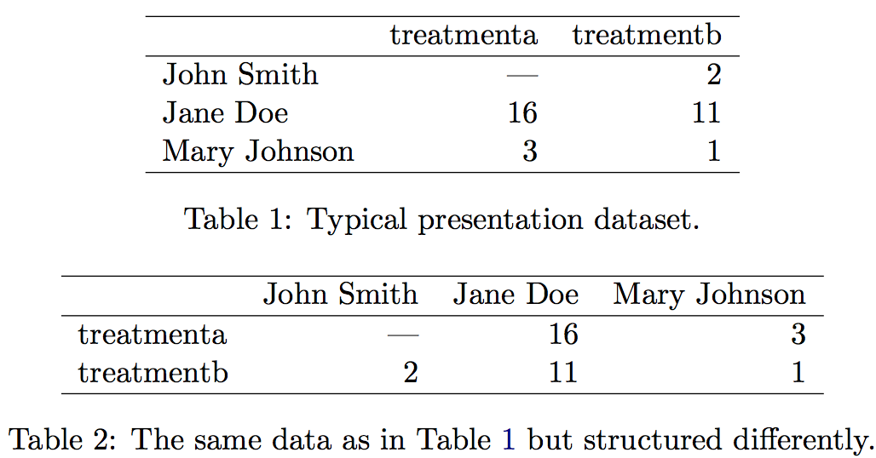
Semantic groups

Slide 10
Semantic groups
What are the nouns that we see?
Humans (names – text codes)
Treatments (text codes)
Results (numerical)
These are now our columns

Slide 11
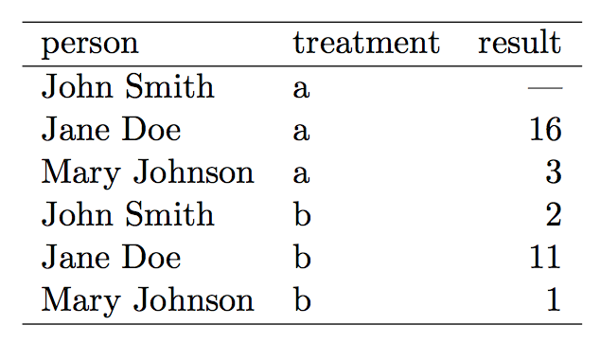
The tidy* version
Each variable forms a column
Each observation forms a row.
Each type of observational unit forms a table.

Slide 12
Why this feels like a database
This is Codd’s 3rd normal form (Codd 1990), but with the constraints framed in statistical language, and the focus put on a single dataset rather than the many connected datasets common in relational databases.

Slide 13
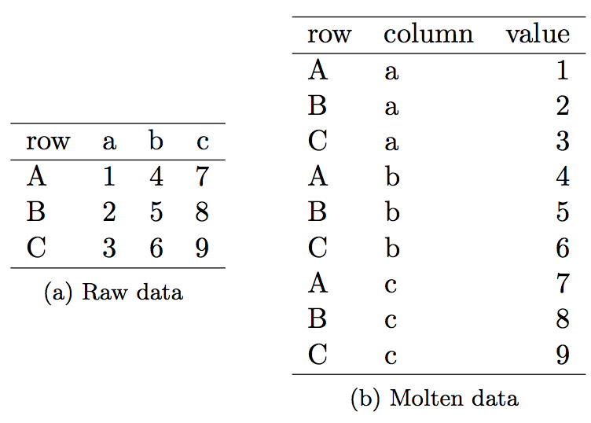
Melting data

Slide 14
Live demo of Pivot Charts
Go into Google Sheets
Make a new sheet
File -> Import
Upload the cleanedsurvey.csv file you downloaded
Let’s talk about these options
We need to go in and make weight numeric
Once you have the data we can play with pivot charts

Slide 15
Live demo of Pivot Charts
Data -> Pivot Table
It’ll look blank and weird, but look on the right
Select what you want to aggregate, by rows and columns
Add Species to rows
Add Sex to columns
Add Weight to Values and select Average
Note the errors!
Add Filter and remove blanks from weight
Play with using COUNTA for summarizing
Play with adding more values
Insert Chart!

